Slide 1
Colonial Pipeline Attack on Critical Infrastructure
Prashant

Slide 2
Agenda: Colonial Pipelines Cyber Attack
Kipling’s Six Honest Serving Men !
“Who” is Colonial Pipeline
“What” happened on Colonial Pipeline
“When” it happened on Colonial Pipeline
“Where” it happened on Colonial Pipeline
“How” it happened on Colonial Pipeline
“Why” it happened on Colonial Pipeline
Impact of the Cyber Incident
Advisories on the Cyber Incident
Lessons for Enbridge

Slide 3
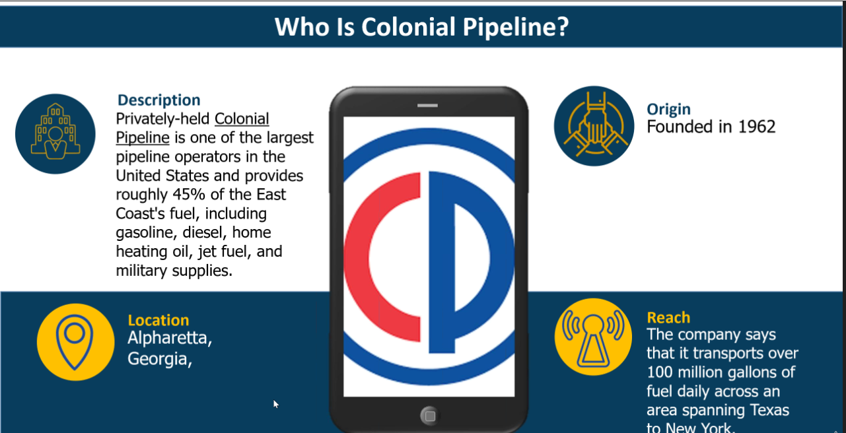

Slide 4
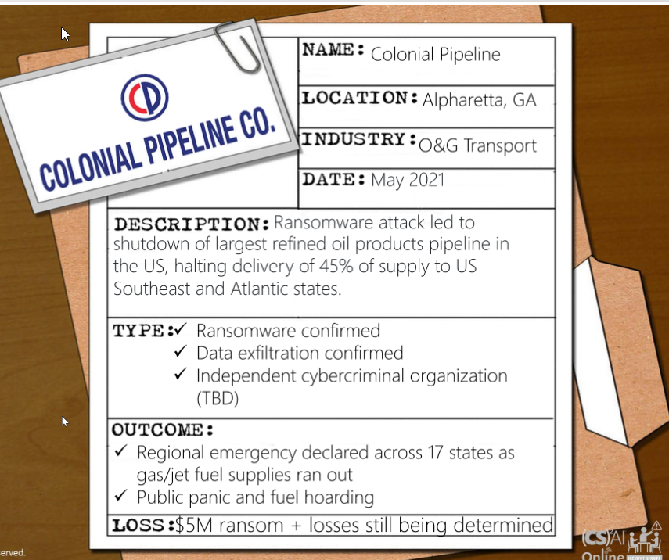
What happened on Colonial Pipeline

Slide 5
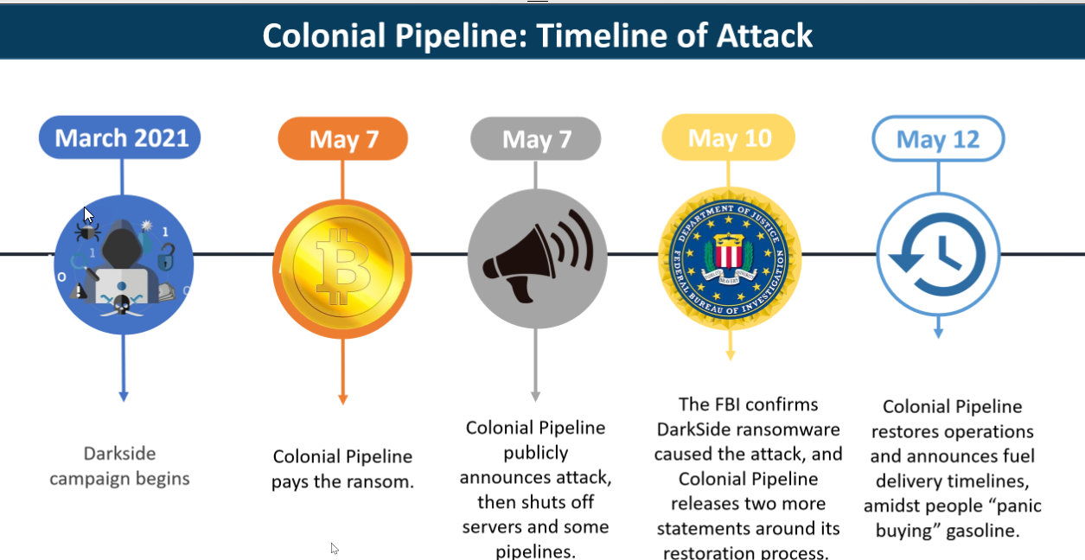
When it happened on Colonial Pipeline

Slide 6
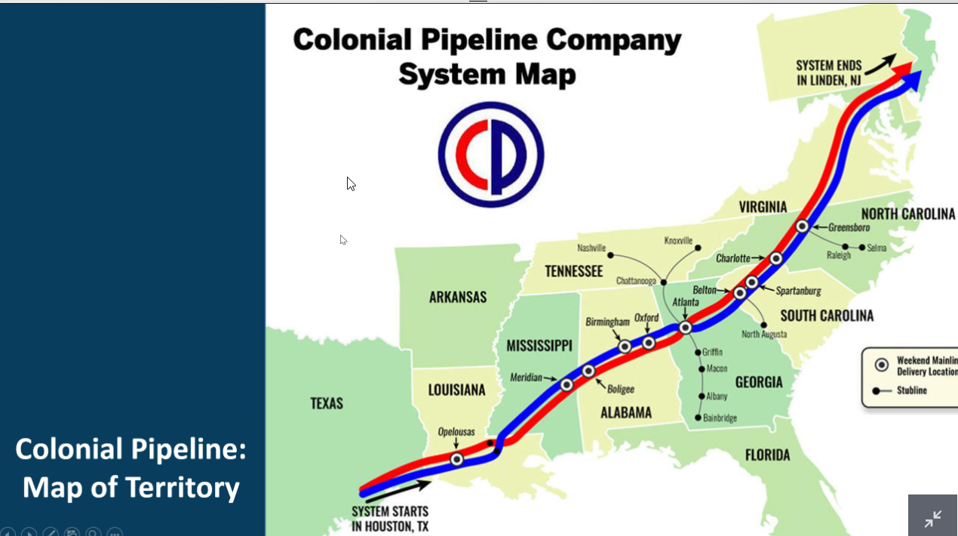
Where it happened on Colonial Pipeline

Slide 7
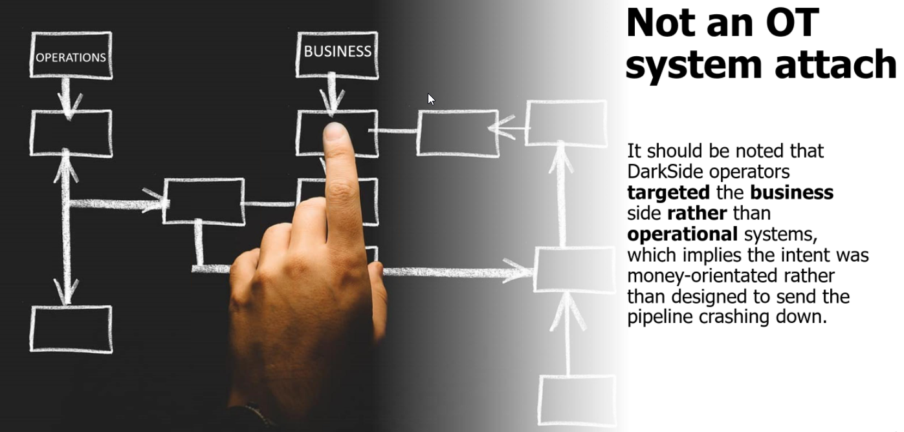
How it happened on Colonial Pipeline
Dark Side went after low hanging fruits: Billing System on Corporate IT Network was compromised.
Basic Blocking and Tackling tactics was used
All indications say IT systems were attacked and impact was a precautionary shutdown on OT systems
IT and OT distinctions have blurred now
Double extortion ransom scheme was employed.
Ransom worth $4.4million was paid to Dark Side (CEO made decision) before information was made public.
Restore from backup was employed as decryption was taking too long
Downstream immediate impact to human life made this attack public and more prominent even though 4 such similar critical infrastructure incidents happened in US
Ransomware As a Service Model, Rent Botnets, Customer Service on Dark Web

Slide 8
Why it happened on Colonial Pipeline
There are several reasons that Colonial might have chosen to shut down the pipeline:
Ransomware had disrupted the functionality of OT systems.
The attacker had control over OT systems.
There is reasonable belief that the attacker or ransomware will or already has spread from the
IT network to OT network
4. The ransomware had impacted the business operations of the company
Although it was not initially clear, CNN has confirmed that
“The company halted operations because its billing system was compromised”.
While OT systems are often segregated from IT systems, both IT and OT systems play important parts in the business activities of industrial organizations such as Colonial Pipeline.
It is unsurprising therefore that, lacking the ability to track product and determine how to bill its customers, Colonial would halt operations on the pipeline until it regained that visibility and capability.

Slide 9

Impact of the Cyber Incident
Impact
Ransomware Cyber attack on Colonial Pipelines led to shutdown of 45% of US East Coast supply of diesel, petrol and jet fuel. (2.5 million barrels a day compare that to 3 million barrels/day on Enbridge Mainline) .
Downstream impact to human life, gasoline shortage, airplanes, cargo, trucks, cars. Hoarding of fuel happened. Postal Service, FedEx, Amazon, Airports, Police, Healthcare, Fire and EMS were affected.
US Congress is seriously considering the introduction of Pipeline Security Act and strengthen the CISA Cybersecurity Information Sharing Act (to streamline DHS function vis a vis Cyber Security) https://en.wikipedia.org/wiki/Cybersecurity_Information_Sharing_Act
The White House issued Executive Order to strengthen Cyber Security and its has some significant implications around: Supply Chain, Vendor onboarding, sharing of Cyber incidents among industry/government etc.
Discussion: Ensure proper adherence to Cyber Security Standards and be vigilant on IT systems
Notes:
Sources:
https://www.bbc.com/news/business-57050690
https://www.nbcnews.com/tech/security/colonial-pipeline-hack-claimed-russian-group-darkside-spurs-emergency-rcna878
https://www.cisa.gov/ransomware

Slide 10
Some Advisories on the Cyber Incident FBI Flash, Joint CISA/Dept of Justice, E&Y Blog, IoN United Blog
https://www.ionunited.com/news/colonial-pipeline-attack-faq/

Slide 11
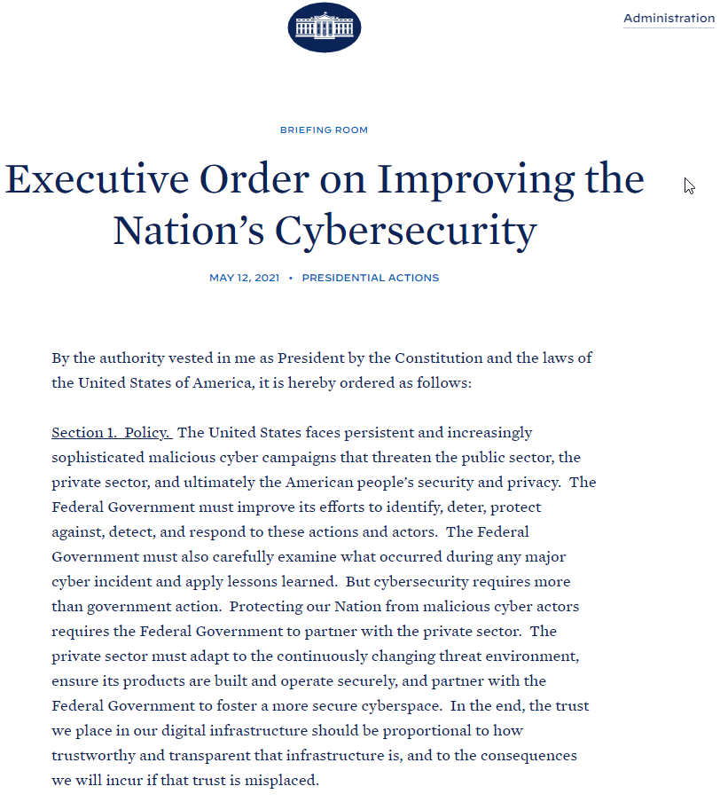
White House Executive Order

Slide 12
Practical Take Away Lessons:
Critical step to reduce likelihood of such a Cyber Incident
MFA- all and certainly privileged accounts on IT and OT networks can be applied
Managing risks from phishing emails- email filtering and a user training program with simulated phishing tests
Out of date, end of life, unpatched software, applications, firmware etc. Ensure all Internet facing devices are fully up to date and patched
Limited access to resources over networks-limit remote network protocol- generally activated by default
Monitor and block inbound connections from anonymization services (such as TOR). Block by default
What can we do to minimize the impact and consequences should our organization be hit with ransomware?
To the extent that your org is using OT, ensuring strong segmentation between the business network and the OT network. Defining the DMZ and limit all comms between
Identify interdependencies between the OT and IT - could be technical connections, identify and eliminate those not necessary. This also means ensuring the OT network can operate without the IT network (if compromised). Ensure no functional dependencies.
Ensure your org has identified the most critical data, and store the backups offline, maintain gold images of critical systems, back up source code and executables, roll back to known good version
Report to federal law enforcement

